Slide 1
Game AI – Case Study
8 Puzzle Problem
Introduction to Game Design and Development
ITCS 4230/5230
Dr. Dewan Tanvir Ahmed
Department of Computer Science
University of North Carolina at Charlotte

Slide 2
8-Puzzle
Slide tiles until they're in numerical order.
What strategy to use to solve puzzle ?
No obvious algorithm
From this position,
Three successor positions.
From each of these,
Two, three, or four successors.
And so on.
Sounds like a tree?
Yup.
7
3
5
1
8
4
2
6
7
3
5
7
3
5
7
3
5
1
4
1
8
4
1
8
4
2
8
6
2
6
2
6

Slide 3

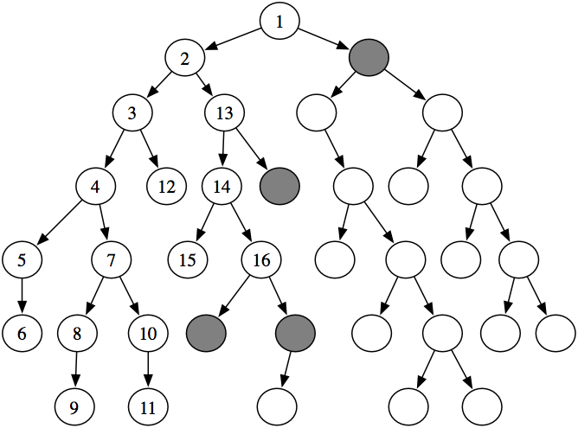
Search: Abstract Definition
How to search? Generic search algorithm
Given a graph, a start and goal nodes, and incrementally explore paths from the start nodes to reach the goal.
Frontiers
Notes:
Start at the start state
Evaluate where actions can lead us from states that have been encountered in the search so far
Stop when a goal state is encountered

Slide 4
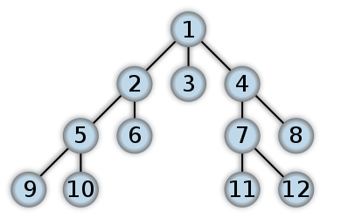
8-Puzzle: Breadth-First Search (BFS)
Search the tree for Goal node, one level at a time

Slide 5
8-Puzzle: Depth-First Search (DFS)
Search for Goal down to some depth (the search "horizon").
Notes:
How appropriate are these search approaches?

Slide 6
8-Puzzle
Blind Search algorithms
Use no domain knowledge of the problem state.
Breadth-First and Depth-First are "blind" searches.
Exhaustive methods for finding path to goal.
Often infeasible because too many nodes expanded.
Success (eventually) guaranteed.

Slide 7
8-Puzzle
"Heuristic" search –
A Heuristic is a function that, when applied to a state, returns a number that is an estimate of the merit of the state, with respect to the goal.
Use "evaluation function" to rank successor nodes; pick best.
1
2
3
Heuristics that only underestimate are very desirable, and are called admissible.
7
4
8
5
6
Notes:
In other words, the heuristic tells us approximately how far the state is from the goal state*.
Heuristics might underestimate or overestimate the merit of a state. But for reasons which we will see, heuristics that only underestimate are very desirable, and are called admissible.

Slide 8
8-puzzle: Heuristic I
The number of misplaced tiles (not including the blank)
3
2
8
1
2
3
4
5
6
4
5
6
7
1
7
8
Current State
Goal State
In this case, the heuristic function evaluates to (1+1+1) = 3.
Notation: h(n) h(current state) = 3
Notes:
In other words, the heuristic is telling us that it thinks a solution might be available in just 3 more move.

Slide 9
8-puzzle: Heuristic II
Manhattan Distance:
The distance between two points measured along axes at right angles.
3
2
8
1
2
3
4
5
6
4
5
6
7
1
7
8
Current State
Goal State
3
3
8
1
8
1
2 spaces
3 spaces
3 spaces
In this case, only the “3”, “8” and “1” tiles are misplaced h(n) = 2 + 3 + 3 = 8.

Slide 10
8-puzzle: Example 1
We can use heuristics to guide “hill climbing” search.
the Manhattan Distance heuristic helps us quickly find a solution to the 8-puzzle.
h(n)
5
6
4
3
But “hill climbing has a problem...”
4
2
1
3
3
0
2

Slide 11
8-puzzle: Example 2
In this example, Greedy Search (hill climbing) does not work!
Stuck at local minima.
Note that this puzzle is solvable.
1
2
3
h(n)
4
5
8
6
6
7
1
2
3
1
2
3
4
5
8
7
4
5
5
6
7
6
7
8
1
2
3
1
2
4
5
6
4
5
3
6
6
7
8
6
7
8

Slide 12
Two interesting algorithms
Uniform Cost Search
Best first search with evaluation function g(n)
g(n) = work done so far
optimal and complete but can be very slow.
g(n)
n
s
d
5
2
5
2
5
2
1
7
1
7
Intuition: Expand the cheapest node. Where the cost is the path cost g(n)
4
5

Slide 13
Two interesting algorithms
Greedy Search
Estimates how far away the goal is [evaluation function h(n)].
Neither optimal nor complete.
Can be very fast.
h(n)
n
s
d
17
19
17
19
17
19
16
14
16
14
13
15
Intuition: Expand the node you think is nearest to goal. Where the estimate of distance to goal is h(n)

Slide 14
Two interesting algorithms
Quiz
Can we combine them (uniform cost and hill climbing) to create an optimal and complete algorithm that is also very fast?

Slide 15
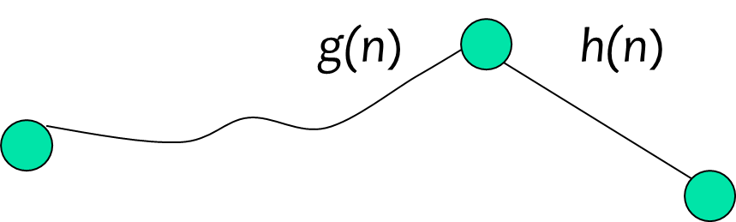
The A* Algorithm (“A-Star”)
Enqueue nodes in order of estimate cost to goal, f(n)
g(n) is the cost to get to a node.
h(n) is the estimated distance to the goal.
f(n) = g(n) + h(n)
n
If the heuristic is optimistic, that is to say, it never overestimates the distance to the goal, then A* is optimal and complete!
Notes:
Note that we can use the general search algorithm we used before.
All that we have changed is the queuing strategy.

Slide 16
Thank you!

